Slide 1
Deploying SharePoint Framework Components to Production
Overview
Notes:
Recorded version of this lesson available at;
https://www.youtube.com/watch?v=DLi6ZviEIJ8

Slide 2

Overview
Objects & Files involved in Deployment
Build, Bundle & Ship
Deploying SharePoint Assets
Deployment Steps

Slide 3
SharePoint Framework Deployment Artifacts
Installation & registration files
Included in SharePoint package deployed to SharePoint app catalogs
Makes SharePoint aware of components
Includes:
App manifest
Feature framework files
etc.
Component runtime files & dependencies
Optionally included in SharePoint package or deployed to another location (CDN)
Referenced by SharePoint when components are loaded on pages
Includes:
JavaScript bundles
Images
CSS
etc.

Slide 4
Build, Bundle & Package Solution
Build
gulp build
Transpiles TypeScript to JavaScript
Generates TypeScript type declarations
Transpiles SCSS to CSS
Bundle
gulp bundle [--ship | -p]
Generates JavaScript bundle(s)
Generates component manifest(s)
Files added to /dist folder
Package Solution
gulp package-solution [--ship | -p]
Generates all files needed for deployment to SharePoint
Generates all files needed to run components
Creates *.sppkg file
Files added to /temp & /sharepoint folder
Files added to /lib folder

Slide 5
Different Build / Packaging Modes: Debug & Production
Debug
All generated files are left un-minified
JavaScript source map files included in transpilation process
Built files assumed to be loaded from local webserver (https://localhost:4321)
Production
All files minified
No JavaScript source map files generated
Built files assumed to be loaded from ultimate production locations (CDN)

Slide 6
Deploying SharePoint Assets
SharePoint package (*.sppkg) always deployed to SharePoint App Catalog
Tenant-scoped App Catalog
Site Collection-scoped App Catalog (SharePoint Online only)
Component executable files deployed to hosting location
Must be accessible to all users of the site
Multiple manual options:
Office 365 CDN
Azure CDN
Public / internal URL
Leverage the includeClientAssets in the project’s package-solution.json file
Includes executable files in the *.sppkg
Automatically deployed to Office 365 tenant’s CDN’s

Slide 7
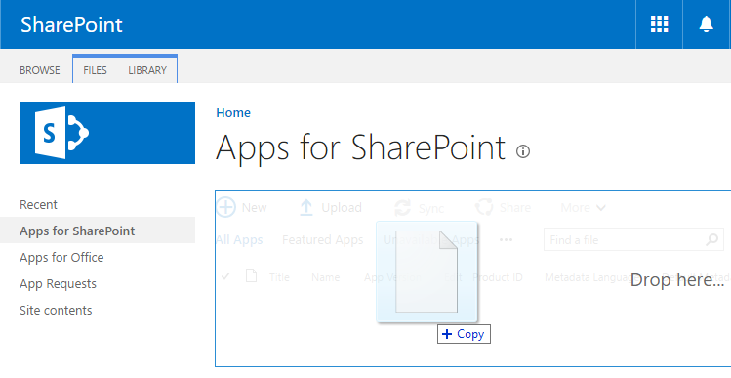
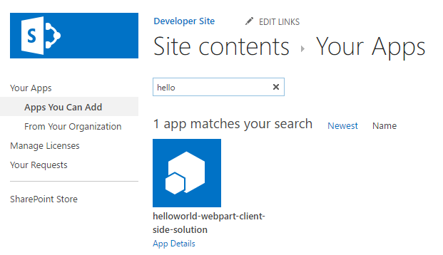
Deployment & Installation Steps
Build the project
gulp build
Generate the bundle & manifests
gulp bundle --ship
Generate the SharePoint package
gulp package-solution –ship
Upload the package (*.sppkg) to the app catalog
Install the app from the site collection’s Site Contents page

Slide 8
Demo Build, Bundle, Package, Deploy & Install a SharePoint Framework Solution
Notes:
Lab steps:
https://github.com/SharePoint/sp-dev-training-spfx-deployment/tree/master/Demos/01-deployment

Slide 9

Summary
Objects & Files involved in Deployment
Build, Bundle & Ship
Deploying SharePoint Assets
Deployment Steps

Slide 10
Deploying SharePoint Framework Components to Production
Site Collections & Application Lifecycle Management APIs

Slide 11
Site Collections & Application Lifecycle Management APIs
Tenant Scoped App Catalog
Site Collection Scoped App Catalog
ALM APIs

Slide 12
Tenant Scoped App Catalog
Introduced in SharePoint Server 2013
Available in all subsequent on-premises SharePoint Server releases & SharePoint Online
Managed by SharePoint tenant administrators
All assets deployed in SharePoint packages deployed to tenant scoped app catalogs are available to all site collections in the tenant
Can install customizations to all site collections
SharePoint Framework webparts to SharePoint Server 2019 & SharePoint Online
SharePoint Framework app customizers & command set extensions only in SharePoint Online
Does not apply to SharePoint Framework field customizer on all platforms
Notes:
For more information, see:
https://docs.microsoft.com/en-us/sharepoint/dev/spfx/extensions/basics/tenant-wide-deployment-extensions

Slide 13
Site Collection Scoped App Catalogs
Available only in SharePoint Online
Managed by site collection administrators
All assets deployed in SharePoint packages deployed to tenant scoped app catalogs are available only to the site collection
Must be manually created by tenant administrators

Slide 14
Creating Site Collection App Catalogs
Not created by default
Must be created by tenant administrator
Created via command line by connecting to the SPO Admin Center URL
SharePoint Online PowerShell
https://docs.microsoft.com/en-us/powershell/sharepoint/sharepoint-online/introduction-sharepoint-online-management-shell
PS> Add-SPOSiteCollectionAppCatalog -Site https://contoso.sharepoint.com/sites/test-site
PnP PowerShell
https://aka.ms/pnp-powershell
PS> Add-PnPSiteCollectionAppCatalog -Site https://contoso.sharepoint.com/sites/test-site
Office 365 CLI
https://pnp.github.io/office365-cli
$ spo site appcatalog add --url https://contoso.sharepoint/sites/test-site

Slide 15
Removing Site Collection App Catalog
Existing site collection app catalog is not removed, just disabled
SharePoint packages uploaded to it are not deployed & available for installation
Removed via command line
SharePoint Online PowerShell
https://docs.microsoft.com/en-us/powershell/sharepoint/sharepoint-online/introduction-sharepoint-online-management-shell
PS> Remove-SPOSiteCollectionAppCatalog -Site https://contoso.sharepoint.com/sites/test-site
PnP PowerShell
https://aka.ms/pnp-powershell
PS> Remove-PnPSiteCollectionAppCatalog -Site https://contoso.sharepoint.com/sites/test-site
Office 365 CLI
https://pnp.github.io/office365-cli
$ spo site appcatalog remove --url https://contoso.sharepoint/sites/test-site

Slide 16
Application Lifecycle Management REST API
Enables programmatic control over the entire SharePoint package lifecycle
Allows for complex automation in CI/CD scenarios as well as controlling large numbers of deployments
Enables the following scenarios:
Add / Remove SPFx solutions / SharePoint Add-ins to app catalogs
Enable / Disable SPFx solutions / SharePoint Add-ins for installation
Install / Uninstall SPFx solutions / SharePoint Add-ins to a site
Upgrade SPFx solutions / SharePoint Add-ins in a site
List / Get One SPFx solution / SharePoint Add-in within an app catalog
Published as REST APIs
PnP PowerShell, Office 365 CLI & Sites Core Component (CSOM) options as well
Available in SharePoint Online (site & tenant) and in SharePoint 2019 (tenant only)
Notes:
For more information, see: https://docs.microsoft.com/en-us/sharepoint/dev/apis/alm-api-for-spfx-add-ins

Slide 17
Demo Tenant & Site Collection Scoped App Catalogs
Notes:
Demo steps:
https://github.com/SharePoint/sp-dev-training-spfx-deployment/tree/master/Demos/02-appcatalogs

Slide 18
Summary
Tenant Scoped App Catalog
Site Collection Scoped App Catalog
ALM APIs

Slide 19
Deploying SharePoint Framework Components to Production
Updating SharePoint Framework Solutions

Slide 20
Updating SharePoint Framework Solutions
Updating Component Versions
Updating SharePoint Package Versions

Slide 21
Understanding Version Numbers in SPFx Projects
Two things can be versioned in SPFx projects:
Components (web parts & extensions)
Package (*.sppkg)
Not required to increment version when code changes
Deploying updated SharePoint packages without changing the version will update existing code
Component version used for documentation
Package version used for documentation & to trigger SharePoint’s app upgrade process

Slide 22
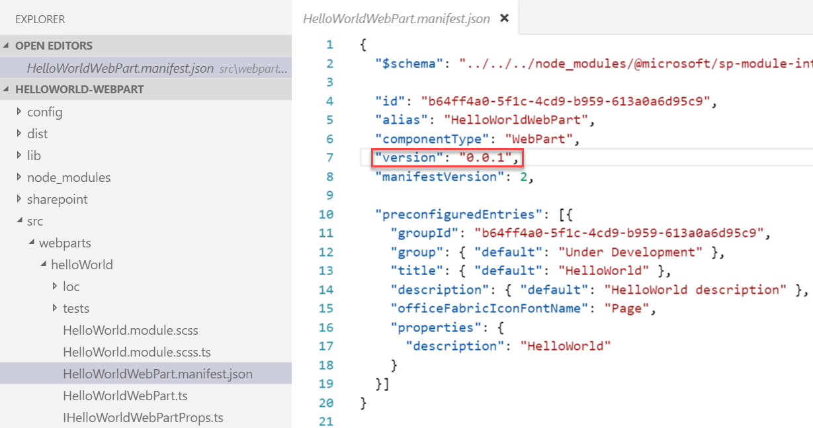
Update SPFx components & incrementing versions
Update the code or configuration for your web part
Increment the version in the <web part name>.manifest.json file
This sets the version for the web part
Multiple web parts in the same solution may be versioned independently

Slide 23
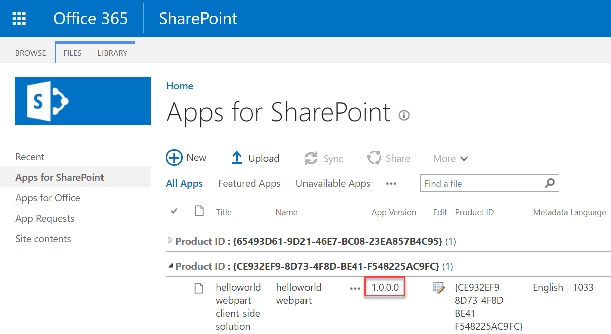
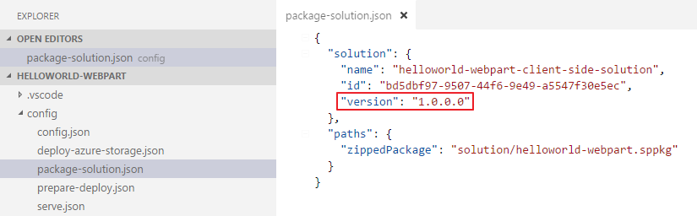
Update the version in the package-solution.json file
Sets the version for the *.sppkg package
Version is displayed in the tenant / site collection App Catalog
Triggers the SharePoint app upgrade process
Will reactivate / upgrade any features

Slide 24
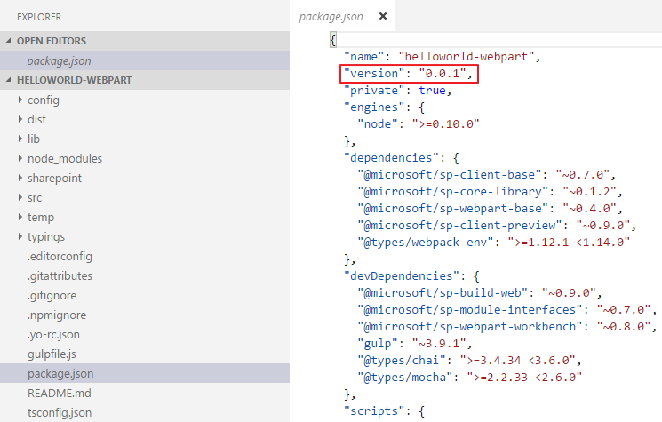
Update the version in the package.json file
Change the component version every time the package changes

Slide 25
Demo Updating SharePoint Framework Component & Package Versions
Notes:
Demo steps:
https://github.com/SharePoint/sp-dev-training-spfx-deployment/tree/master/Demos/03-versions

Slide 26
Summary
Updating Component Versions
Updating SharePoint Package Versions

Slide 27
Reading further
SharePoint Framework
https://docs.microsoft.com/en-us/sharepoint/dev/spfx/sharepoint-framework-overview
Deploy your client-side web part to a SharePoint page
https://docs.microsoft.com/sharepoint/dev/spfx/web-parts/get-started/serve-your-web-part-in-a-sharepoint-page
Use the site collection app catalog
https://docs.microsoft.com/sharepoint/dev/general-development/site-collection-app-catalog

Slide 28
Lab In this lab you will learn how to deploy your SharePoint Framework (SPFx) customizations to production environments. aka.ms/spdevwsM4L8
Notes:
Lab manual at:
https://aka.ms/spdevwsm4l8

